Slide 1

Low Code development with VBCS

Slide 2

VBCS – Visual Builder Cloud Service
Cloud Based Application Development
Based on:
Oracle JET
Javascript, HTML5 & CSS
REST APIs
Requires no IDE
OOTB integrations with
PCS
DevCS
SaaS APIs
CCAs
Stateofjs.com
Low Code
2

Slide 3
History
Started with name Application Builder Cloud Service (ABCS)
Aimed at the citizen Developer
New interface & architecture introduced April 2018
VBCS is no longer just aimed at the “Citizen Developer”
Broader support for Oracle JET UI components
Most development visual (drag & drop)
Coding (javascript, HTML5, CSS) for advanced features possible
New release every 1-2 months
Migrating to new JET releases quickly
Low Code
3

Slide 4

What Gartner says
Magic Quadrant for Mobile App Development Platforms
Low Code
4

Slide 5
When to use VBCS
Oracle SaaS enablement
Create UI for PCS or ICS
Any Cloud Oracle JET application
The No PL/SQL APEX ?
Low Code
5

Slide 6
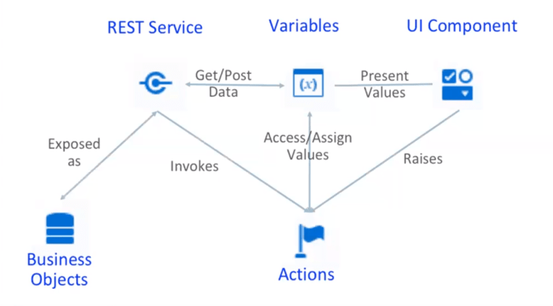
5 Main Building Blocks
Low Code
6

Slide 7

Hands-on Time!
Questions?
Low Code
7

Slide 8
Hands-on: Creating a simple application
First let’s create some accounts
In the meanwhile you can find the hands-on document on GitHub:
https://github.com/AMIS-Services/VBCS-SIG
When account has been created you can start here:
https://visualbuilderhmensingqsvb-hmensing.builder.ocp.oraclecloud.com/ic/builder/
This is roughly what you will create
https://visualbuilderhmensingqsvb-hmensing.builder.ocp.oraclecloud.com/ic/builder/rt/HermanM/live/webApps/mugsapp/
8

Slide 9
Hands-on: what should you learn
Know the building blocks of VBCS
Applications, Flows, Pages
UI Components, Types, Variables
Action Chains, Events
Business Objects, REST services
REST endpoints
Some usefull demo’s -> https://blogs.oracle.com/vbcs/
Oracle JET Cookbook ! -> https://www.oracle.com/webfolder/technetwork/jet/jetCookbook.html
Forum -> https://cloudcustomerconnect.oracle.com/resources/e610f4723c/summary
Low Code
9

